Slide 1

CSE- 321
Software Engineering
Lecture : 13 Software design
Fahad Ahmed
Lecturer, Dept. of CSE
E-mail: fahadahmed@uap-bd.edu

Slide 2
Lecture Outlines
Software design
Design Principles
Strategy of Design
Coupling and Cohesion
Architectural Design
Abstract machine (layered) Design
Distributed Systems Architectures
Client-Server Architecture
Broker Architectural Style : CORBA
Service-Oriented Architecture (SOA)

Slide 3
Software design
What is Software design ?
Software design is a process to transform user requirements into some suitable form, which helps the programmer in software coding and implementation.
Software design is the first step in SDLC (Software Design Life Cycle), which moves the concentration from problem domain to solution domain. It tries to specify how to fulfill the requirements mentioned in SRS.

Slide 4
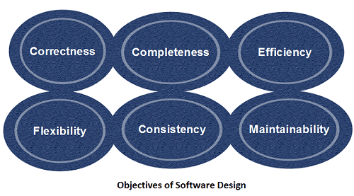
Objectives of Software Design

Slide 5
Objectives of Software Design
Objectives of Software Design
Following are the purposes of Software design:
Correctness: Software design should be correct as per requirement.
Completeness: The design should have all components like data structures, modules, and external interfaces, etc.
Efficiency: Resources should be used efficiently by the program.
Flexibility: Able to modify on changing needs.
Consistency: There should not be any inconsistency in the design.
Maintainability: The design should be so simple so that it can be easily maintainable by other designers.

Slide 6
Software Design Levels
Software design yields three levels of results:
Architectural Design
Highest abstract version of the system.
It identifies the software as a system with many components interacting with each other.
Designers get the idea of proposed solution domain.
High-level Design
Breaks the ‘single entity-multiple component’ concept of architectural design into less-abstracted view of sub-systems and modules and depicts their interaction with each other.
Detailed Design
Detailed design deals with the implementation part of what is seen as a system and its sub-systems in the previous two designs

Slide 7
Software Design Principles
Design is not coding, coding is not design.
The design should be traceable to the analysis model.
The design should not reinvent the wheel.
The design should “minimize the intellectual distance” between the software and the problem as it exists in the real world.
The design should exhibit uniformity and integration.
The design should be structured to accommodate change.
The design should be structured to degrade gently, even when aberrant data, events, or operating conditions are encountered.
The design should be assessed for quality as it is being created, not after the fact.
The design should be reviewed to minimize conceptual (semantic) errors.

Slide 8
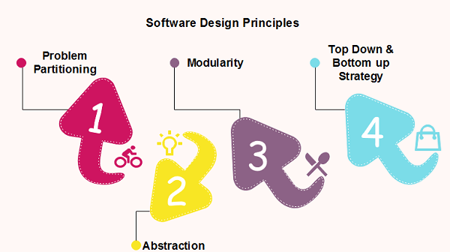
Software Design Principles
Software design principles are concerned with providing means to handle the complexity of the design process effectively.

Slide 9
Software Design Principles
Problem Partitioning
For small problem, we can handle the entire problem at once
but for the significant problem, divide the problems and conquer the problem it means to divide the problem into smaller pieces so that each piece can be captured separately.
Benefits of Problem Partitioning
Software is easy to understand
Software becomes simple
Software is easy to test
Software is easy to modify
Software is easy to maintain
Software is easy to expand
As the number of partition increases = Cost of partition and complexity increases

Slide 10
Modularization
Modularization is a technique to divide a software system into multiple discrete and independent modules, which are expected to be capable of carrying out task(s) independently. These modules may work as basic constructs for the entire software.
Advantage of modularization:
Smaller components are easier to maintain
Program can be divided based on functional aspects
Desired level of abstraction can be brought in the program
Components with high cohesion can be re-used again
Concurrent execution can be made possible
Desired from security aspect

Slide 11
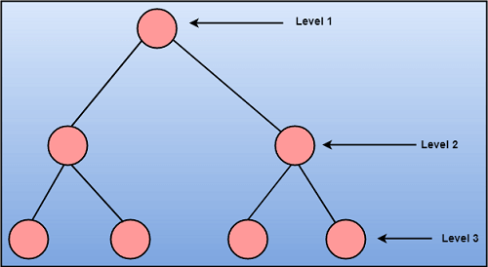
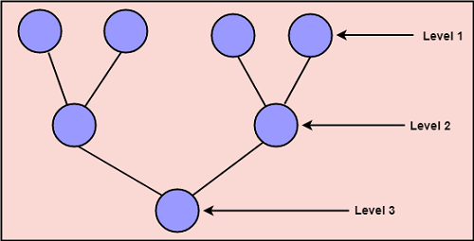
Strategy of Design
To design a system, there are two possible approaches:
Top-down Approach
Bottom-up Approach
Top-down Approach
Bottom-up Approach

Slide 12
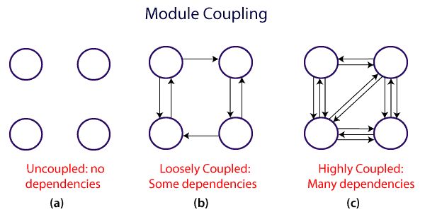
Coupling and Cohesion
Module Coupling
In software engineering, Coupling is measured by the number of relations between the modules. That means, the coupling is the degree of interdependence between software modules.
A good design is the one that has low coupling.

Slide 13
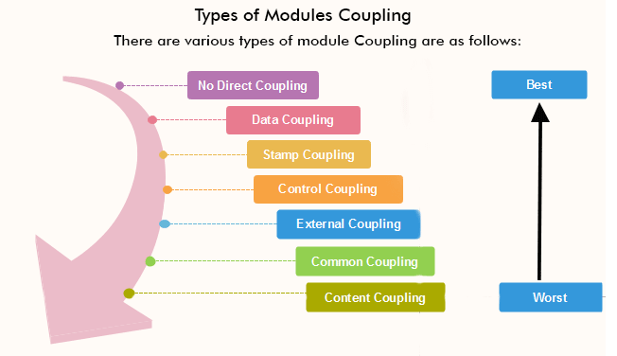
Coupling and Cohesion
Types of Module Coupling
https://www.javatpoint.com/software-engineering-coupling-and-cohesion

Slide 14
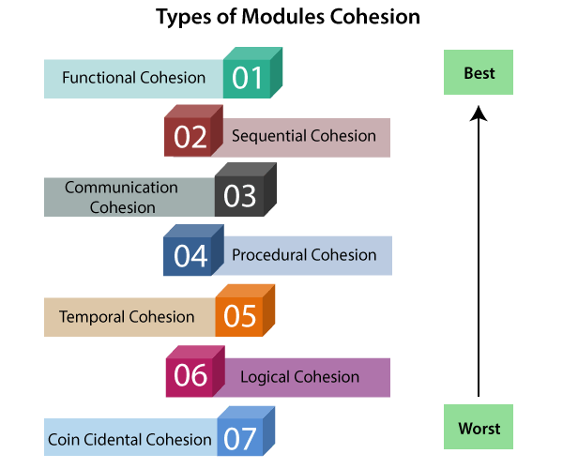
Coupling and Cohesion
Module Cohesion
cohesion defines to the degree to which the elements of a module belong together. Thus, cohesion measures the strength of relationships between pieces of functionality within a given module.
https://www.javatpoint.com/software-engineering-coupling-and-cohesion

Slide 15
Coupling vs Cohesion
Coupling | Cohesion
Coupling is also called Inter-Module Binding. | Cohesion is also called Intra-Module Binding.
Coupling shows the relationships between modules. | Cohesion shows the relationship within the module.
Coupling shows the relative independence between the modules. | Cohesion shows the module's relative functional strength.
While creating, you should aim for low coupling, i.e., dependency among modules should be less. | While creating you should aim for high cohesion, i.e., a cohesive component/ module focuses on a single function (i.e., single-mindedness) with little interaction with other modules of the system.
In coupling, modules are linked to the other modules. | In cohesion, the module focuses on a single thing.

Slide 16

Thanks to All

